Slide 1
The Future of Reporting is Here
MyLCI & MyLion
2:30

Slide 2
What emblem does your club use?
Should be used on all advertising, clothing, correspondence, etc.
The official Lions Emblem/Logo since 2008
Can be downloaded from the LCI website,
search “Logos and Emblems”
o

Slide 3
The Future of Reporting is Here
MyLCI & MyLion
o

Slide 4
What we will cover today
How we got to where we are today
Registering for Access
The basics of MyLCI – (Membership)
The basics of MyLion – (Activities)
Questions & Answers
o

Slide 5
NO LIVE DEMONSTRATION TODAY
o

Slide 6
o

Slide 7
How We Got Here
LCI has always made an effort to track Membership and Activities
Written reporting
Early computer reporting
Apps and advanced computer reporting
o

Slide 8
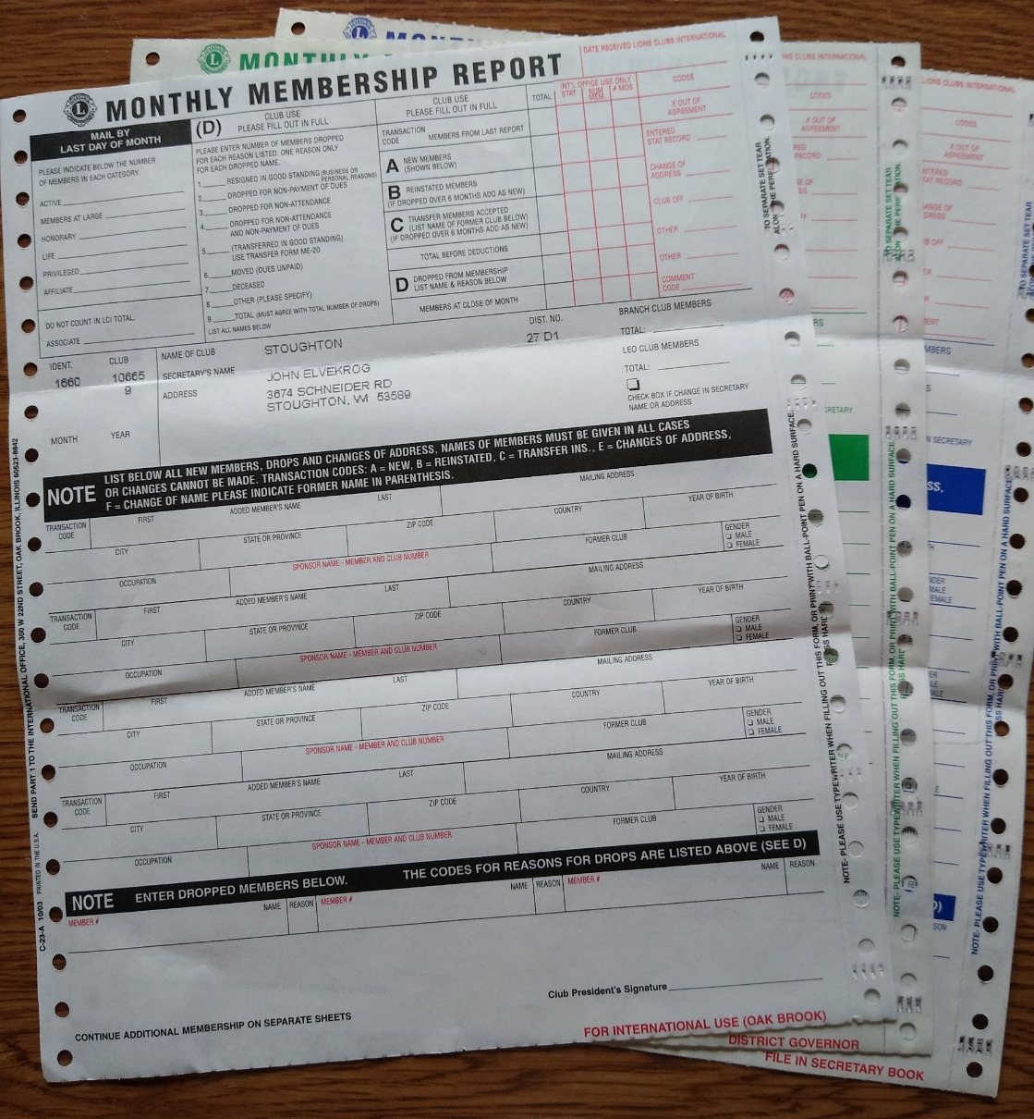
Written Reporting
Monthly
Membership
Report
aka: MMR
Version 2003
o

Slide 9
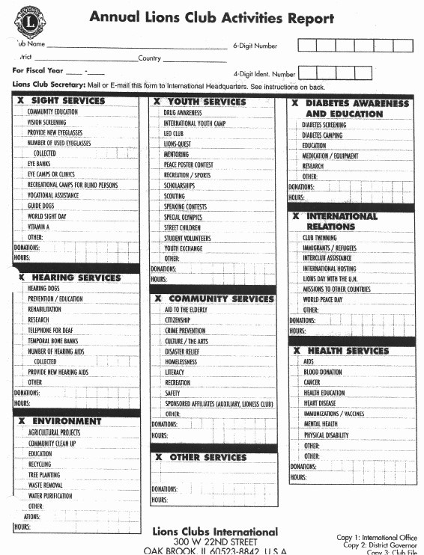
Written Reporting
Around 2009
o

Slide 10
Early Computer Reporting
WMMR for Membership Reporting
Went live around 2005
Option of a web-based reporting/tracking of Membership
Activity reporting was still done by paper
WMMR added Activity Reporting
Went live around 2010
Allowed for web-based reporting/tracking of Activities
LCI stopped recording paper reports
o

Slide 11
Apps & Advanced Computer Reporting
MyLion App on your phone
Rolled out at LCI Conv. 2017 in Chicago
Allowed for planning, reporting, and viewing Activities on a phone app
Unfortunately – many bugs
MyLion Web-based developed
Rolled out at LCI Conv. 2018 in Las Vegas
Allowed for web-based planning, reporting, and metrics searching of Activities using the internet
Activity reporting was removed from MyLCI
o

Slide 12
What Are The Current Tools?
MyLCI – Membership reporting/records
MyLion – Activity reporting/records
o

Slide 13
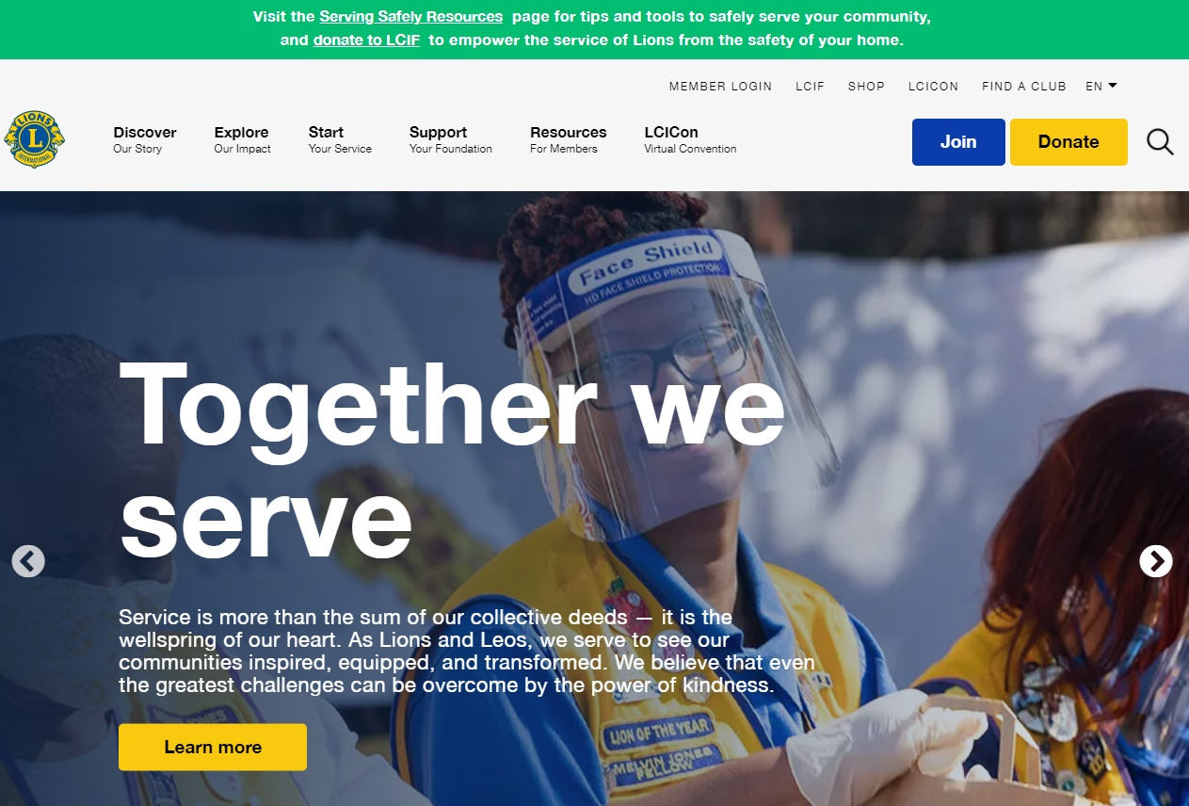
Registering To Use Tools
Any Lion can register to enter the Member Portal
www.lionsclubs.org
o

Slide 14
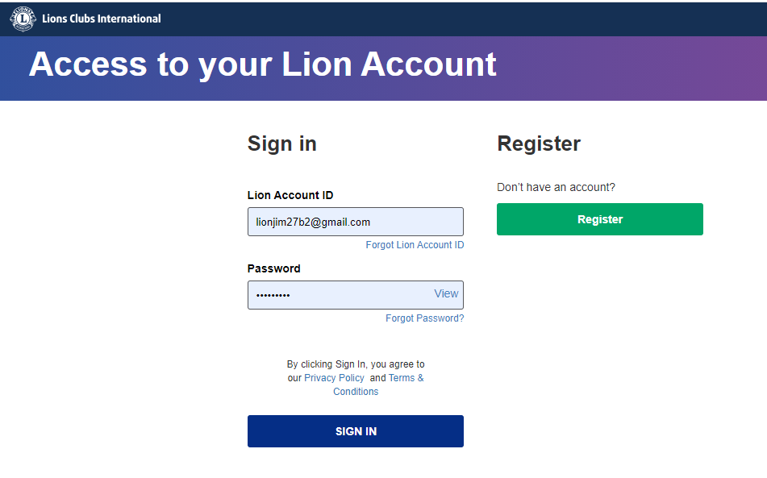
Registering To Use Tools
Member Portal log-in page
o

Slide 15
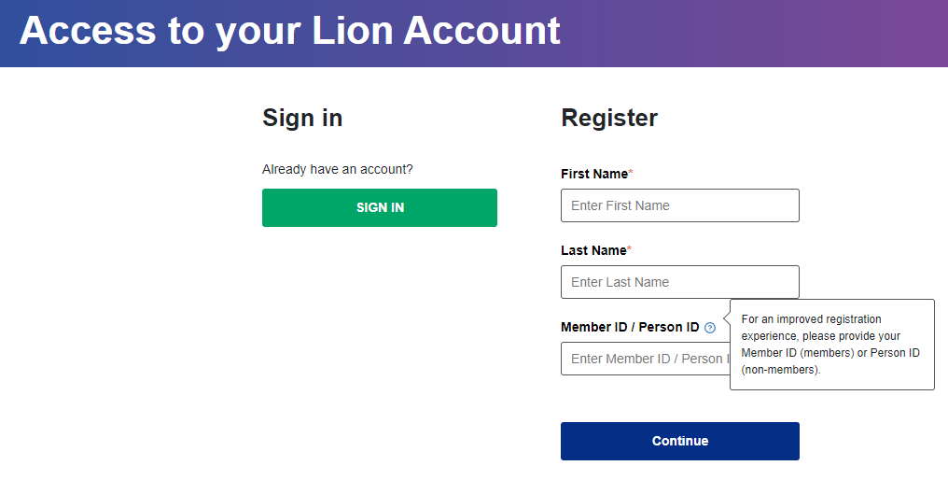
Registering To Use Tools
Member Portal log-in page,
IF you know your member ID #
o

Slide 16
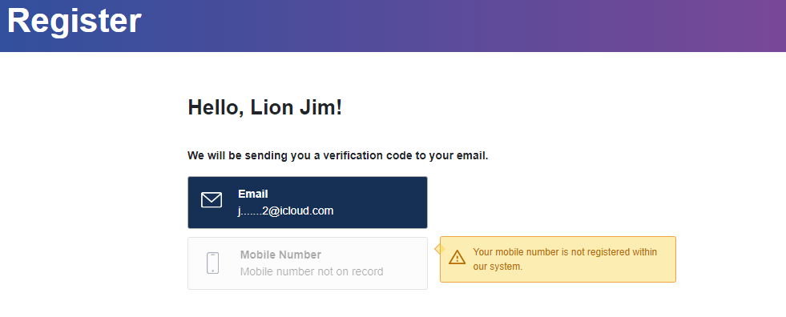
Registering To Use Tools
Member Portal log-in page
o

Slide 17
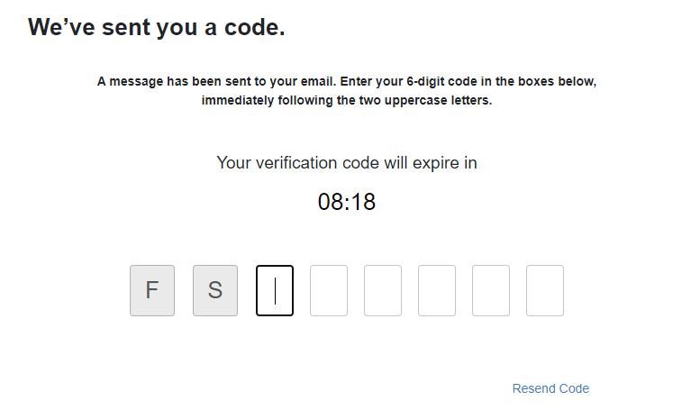
Registering To Use Tools
Member Portal log-in page
o

Slide 18
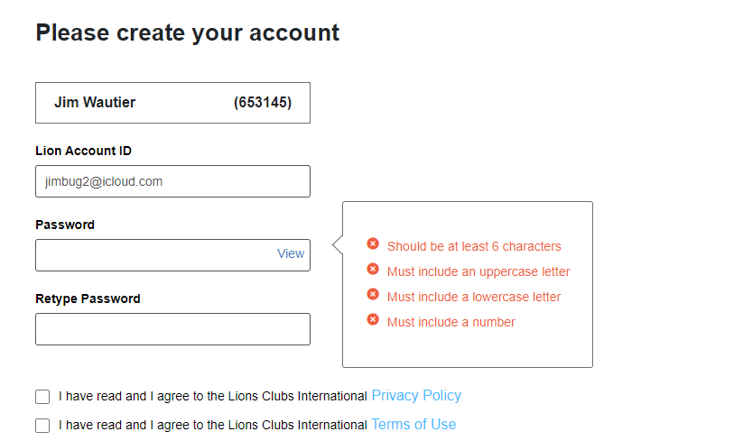
Registering To Use Tools
Member Portal log-in page
o

Slide 19
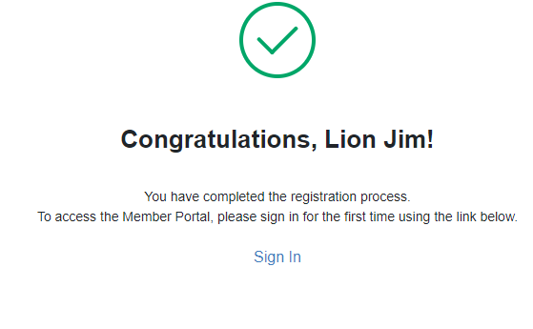
Registering To Use Tools
o

Slide 20
Registering To Use Tools
Member Portal log-in page
o

Slide 21
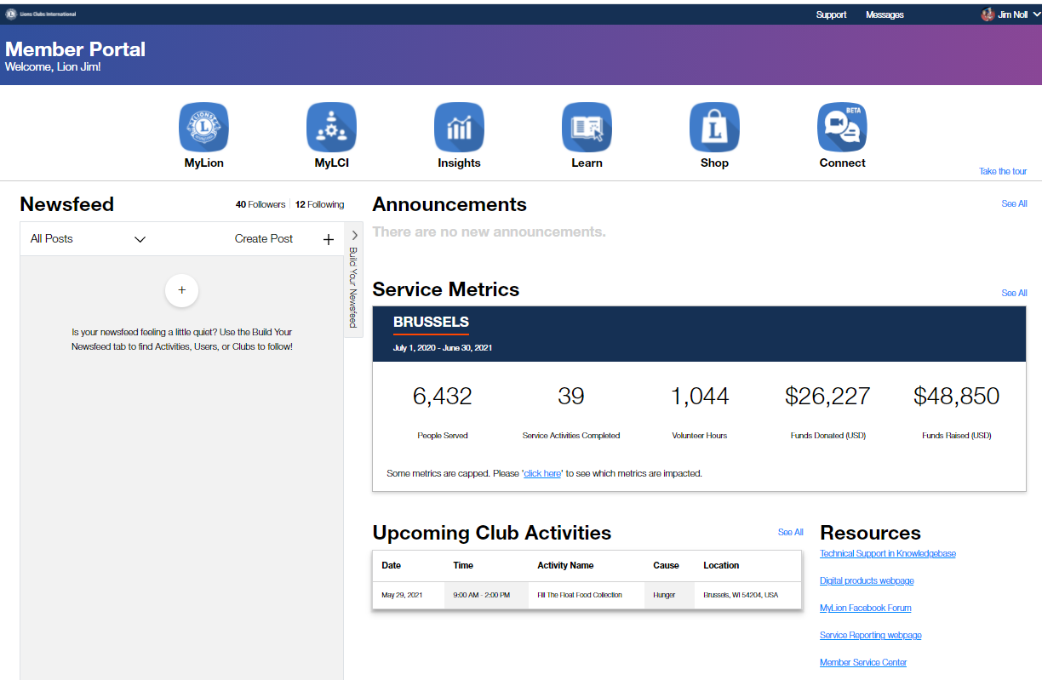
The Member Portal
Your “gateway” to the tools
o

Slide 22
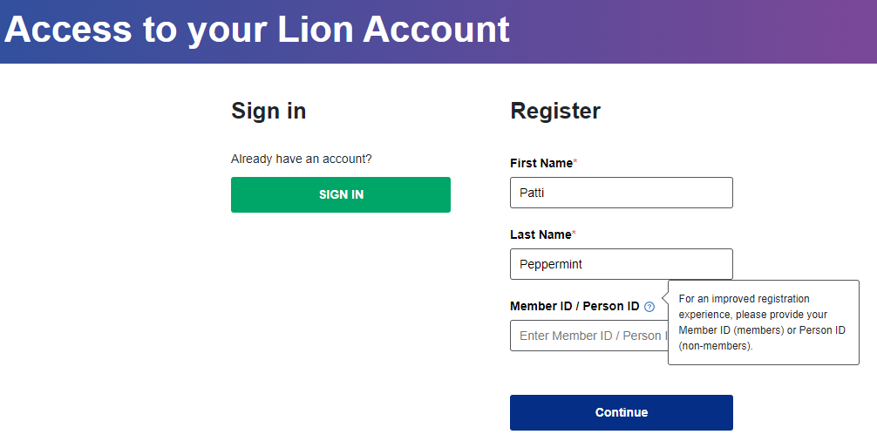
Registering To Use Tools
If you do NOT know your Member ID #
o

Slide 23
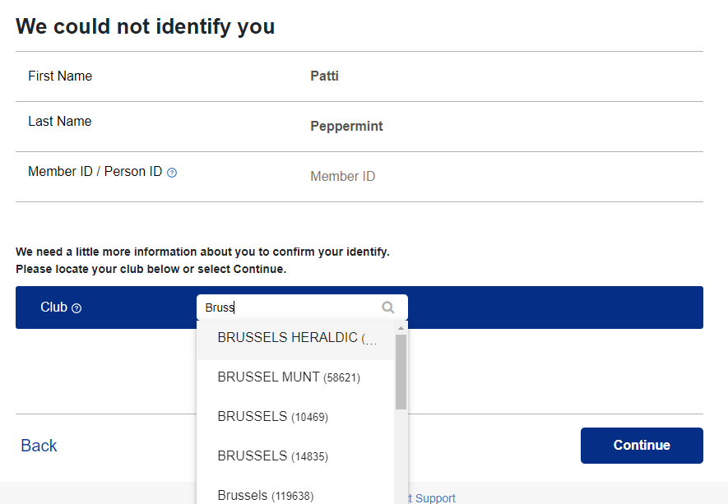
Registering To Use Tools
Do NOT know your Member ID #
o

Slide 24
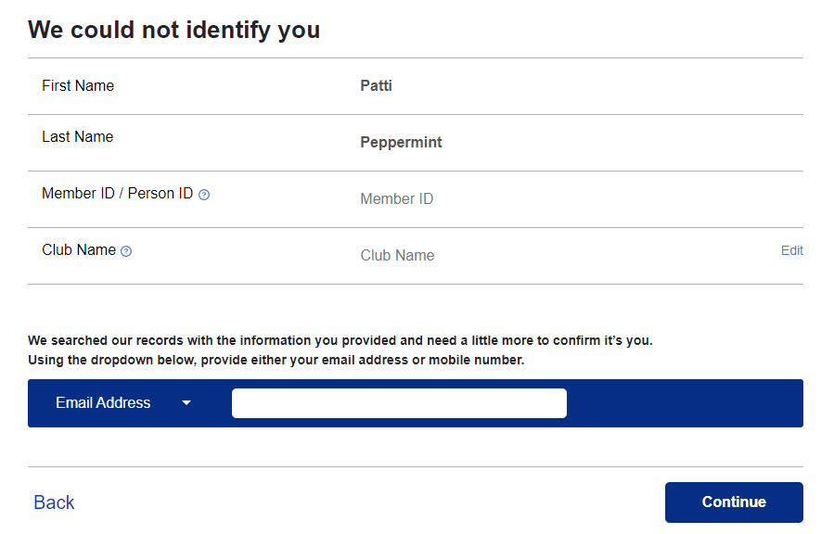
Registering To Use Tools
Do NOT know your Member ID #
o

Slide 25
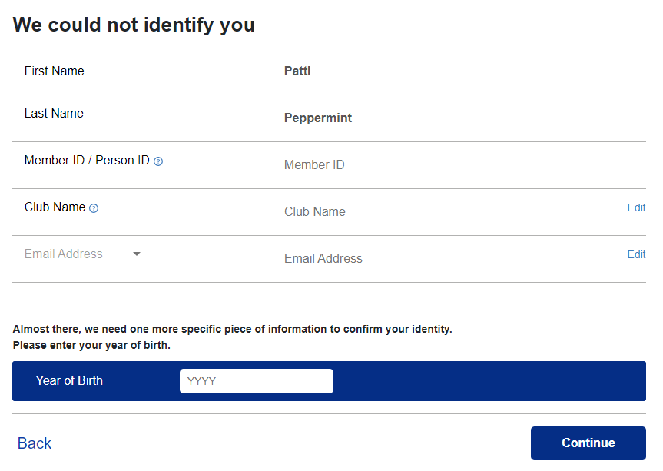
Registering To Use Tools
Do NOT know your Member ID #
o

Slide 26
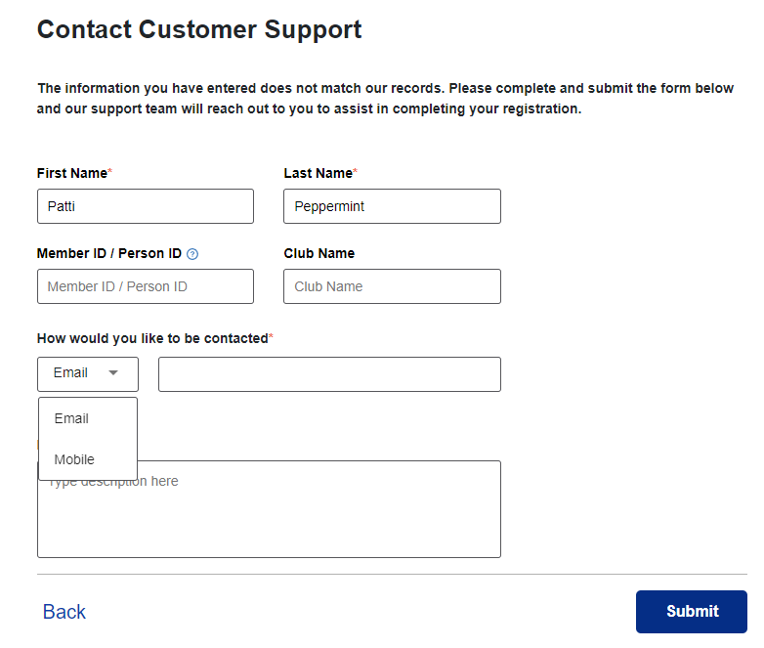
Registering To Use Tools
Do NOT know your Member ID #
o

Slide 27
The Member Portal
Your “gateway” to the tools
o

Slide 28
The Member Portal
Your “gateway” to the tools
o

Slide 29
The Member Portal
Your “gateway” to the tools
o

Slide 30
Getting To MyLCI
Membership Reporting
o

Slide 31
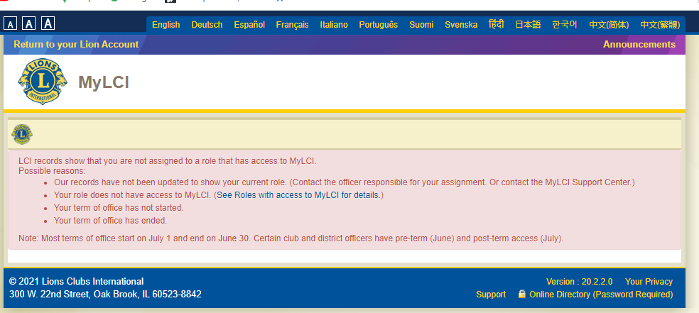
Using MyLCI
(Non-Officer Message)
o

Slide 32
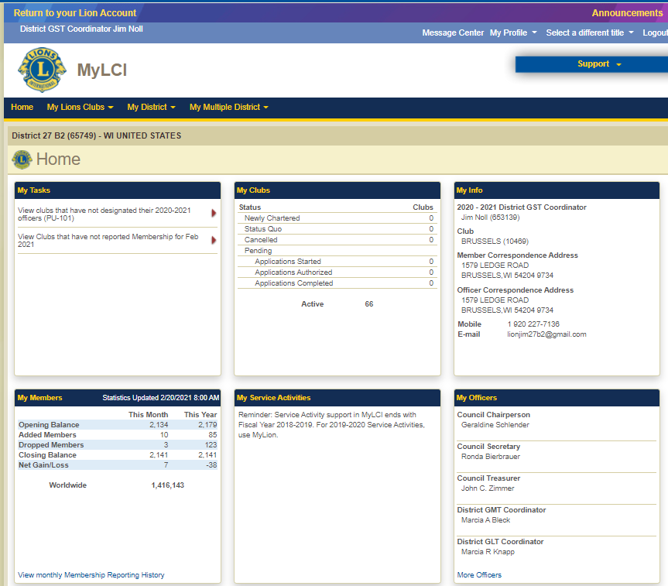
Using MyLCI
(Officer Home Page)
Quick Tour
o

Slide 33
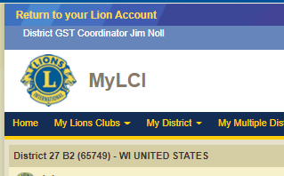
Using MyLCI
(Upper Left)
o

Slide 34
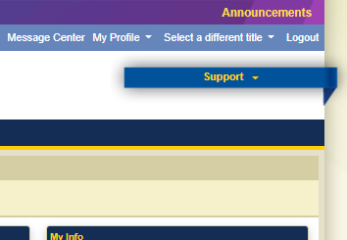
Using MyLCI
(Upper Right)
o

Slide 35
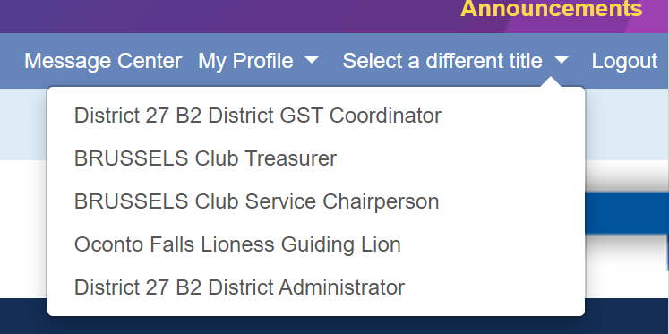
Using MyLCI
(Upper Right)
o

Slide 36
Using MyLCI
(Upper Right)
o

Slide 37
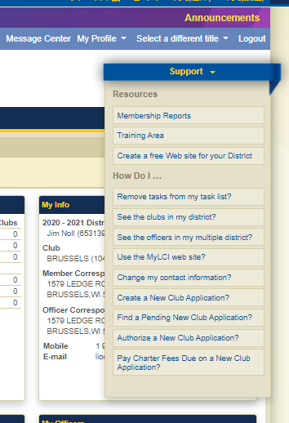
Using MyLCI
(Upper Right)
YOUR HOMEWORK!
Explore the “Support” ribbon
o

Slide 38
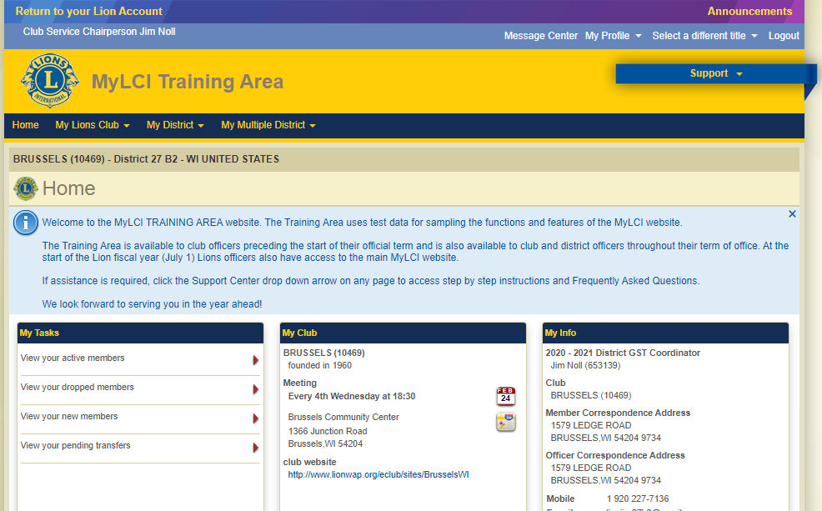
Using MyLCI
(Training Area)
o

Slide 39
Getting To MyLion
Web-based Activity Reporting
o

Slide 40
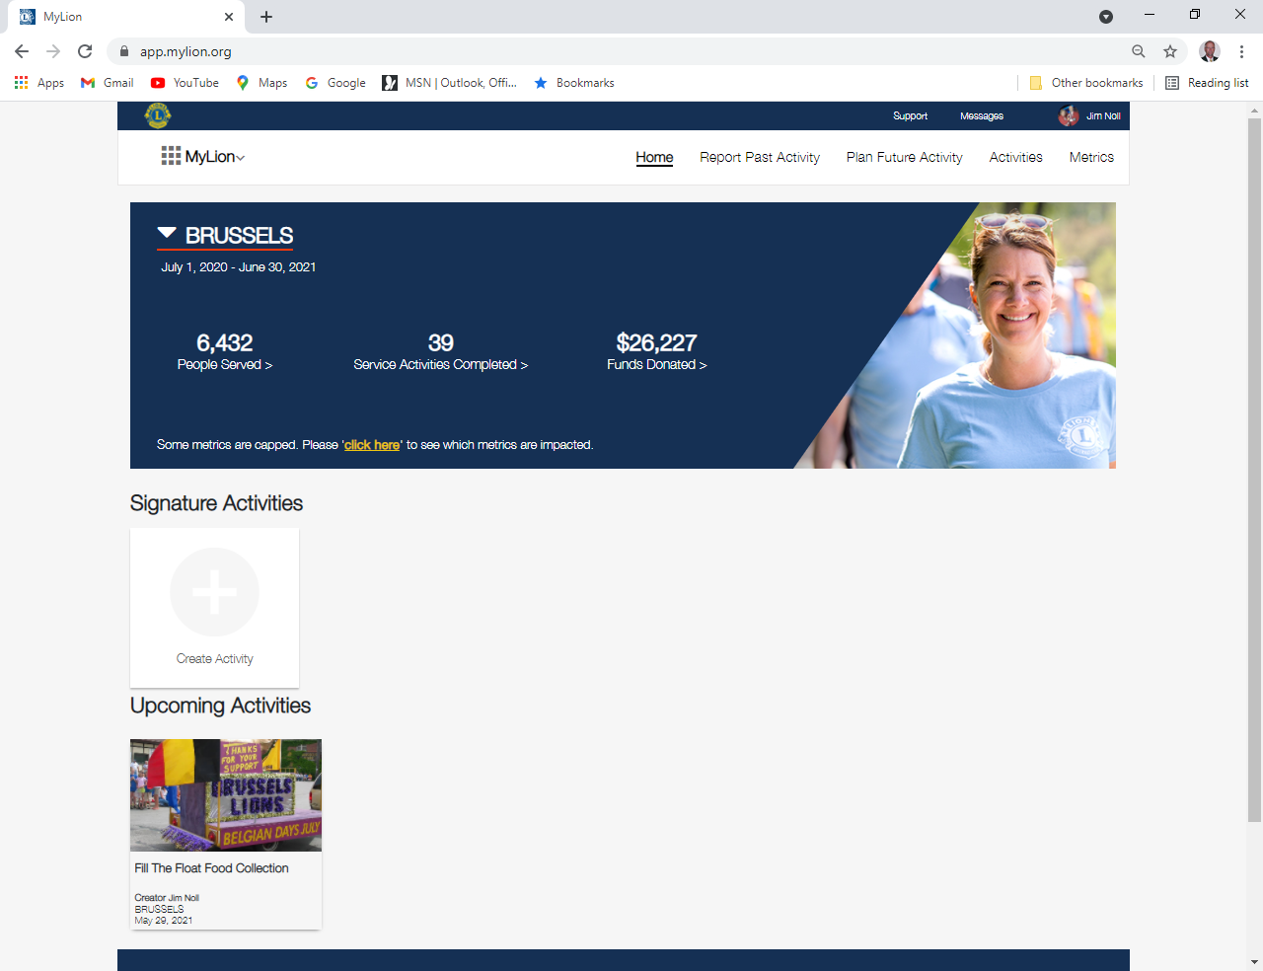
Using MyLion
(Home Page)
Any “registered” Lion can work in MyLion
o

Slide 41
MyLion
Quick Tour
o

Slide 42
Using MyLion
(What Can A User Do in MyLion?)
PLAN a FUTURE Activity (any Lion can do it)
List details you know in advance (description, date, time, location, etc)
Pre-populate some info that you will need for reporting
Set up recurring activities for the entire year (use the copy feature)
Send invites to Lions to notify them of the activity
REPORT a COMPLETED Activity (only certain officers can REPORT an Activity)
Review Activities that have been REPORTED
Look at METRICS for REPORTED Activities
o
Notes:
Who can REPORT:
Secretary,
President,
Club Service Chair,
Club Administrator

Slide 43
(PLANNING)
PLANNING
a FUTURE
Activity
o
Notes:
MULTI-PAGE STEP BY STEP PROCESS
PROVIDES HELP BOXES TO EXPLAIN WHAT YOU ARE PLANNING
Activity Types
Service Activity
Fundraiser
Meeting
Donation
Causes
Hunger
Environment
Childhood Cancer
Diabetes
Vision
Other

Slide 44
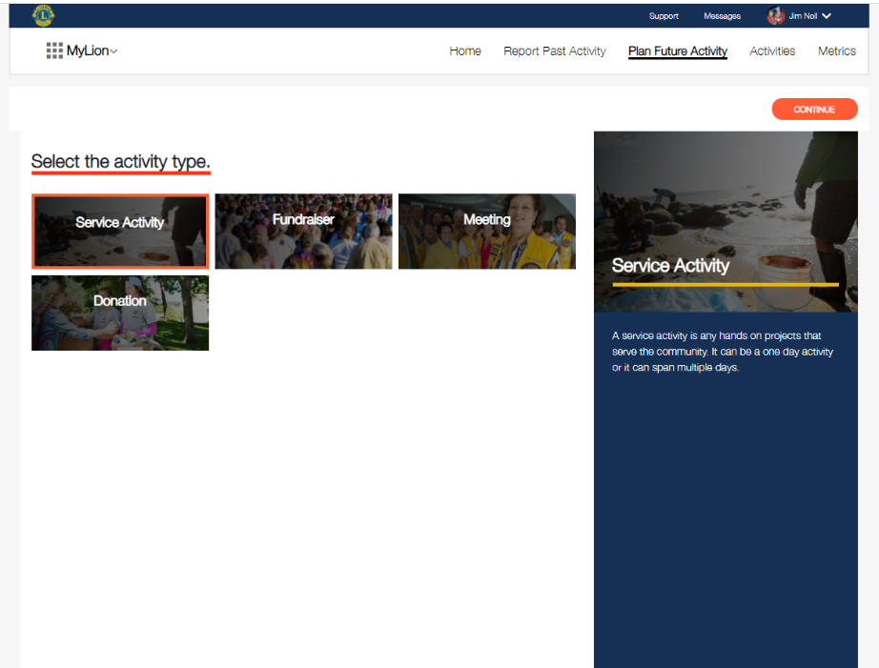
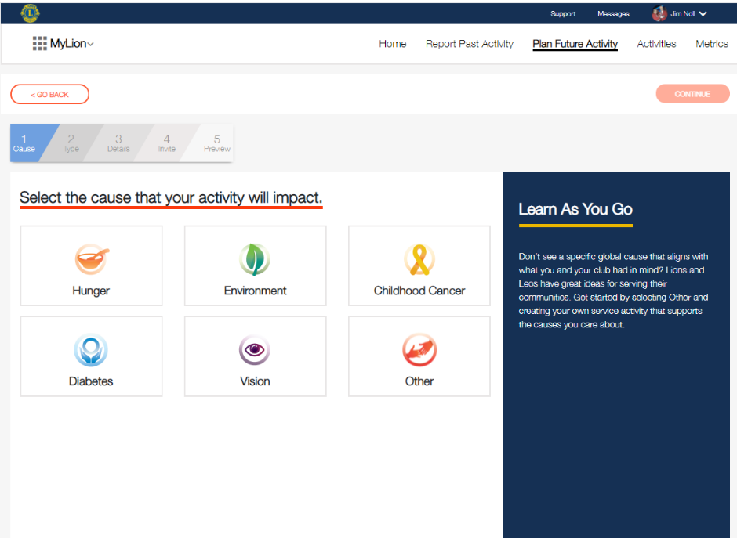
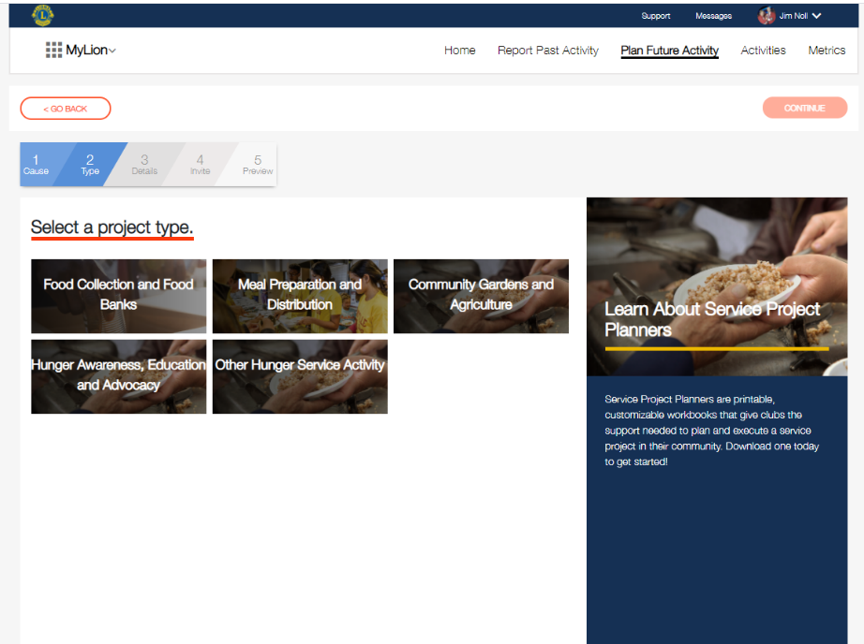
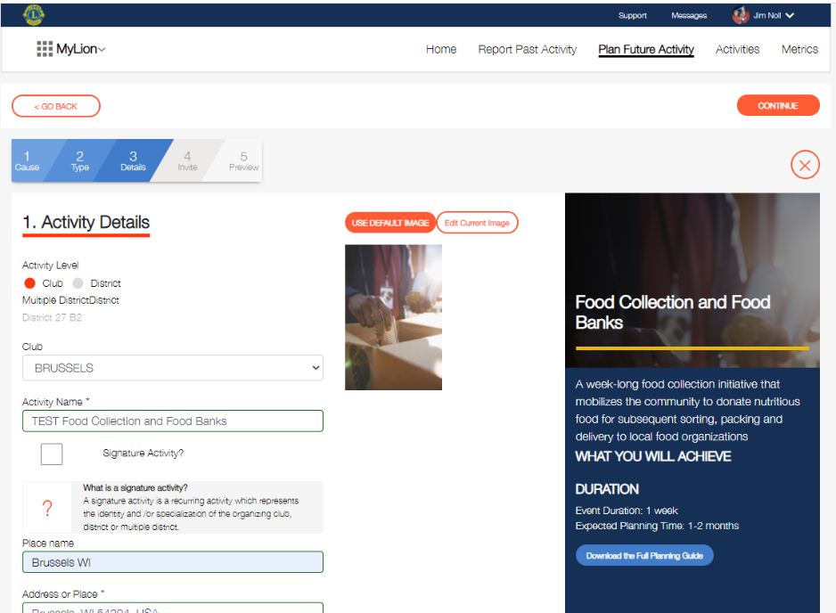
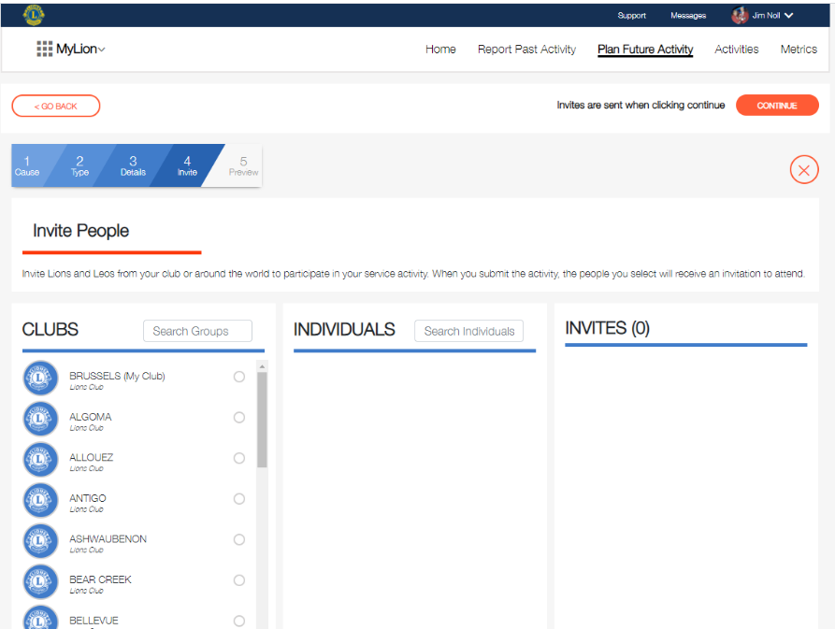
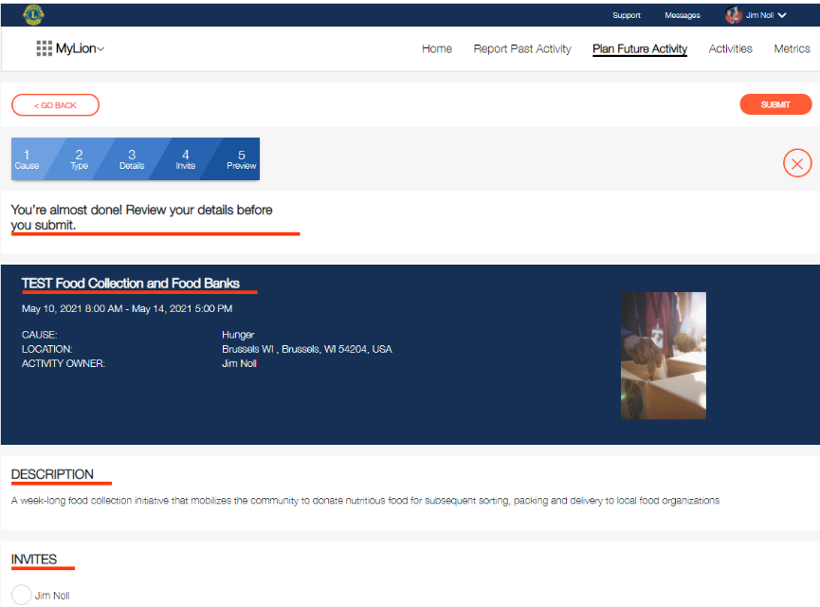
(PLANNING)
1
2
3
5
6
4
o
Notes:
MULTI-PAGE STEP BY STEP PROCESS
PROVIDES HELP BOXES TO EXPLAIN WHAT YOU ARE PLANNING
Activity Types
Service Activity
Fundraiser
Meeting
Donation
Causes
Hunger
Environment
Childhood Cancer
Diabetes
Vision
Other

Slide 45
(REPORTING)
REPORTING a
COMPLETED
Activity
o
Notes:
USED TO BE A MULTI-PAGED PROCESS SIMILAR TO PLANNING AN ACTIVITY

Slide 46
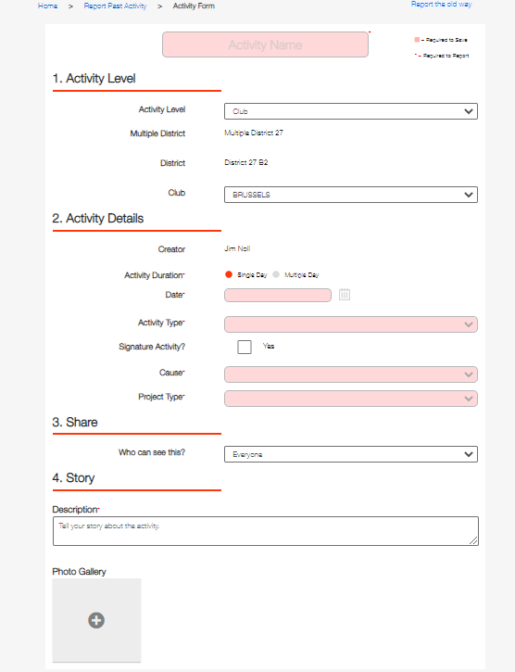
Activity Name
Date
Activity Type
Cause
Project Type
Description
Photos
SAVE vs REPORT
o
Notes:
Activity Types
Service Activity
Fundraiser
Meeting
Donation
Causes
Hunger
Environment
Childhood Cancer
Diabetes
Vision
Other
Additional METRICS optional

Slide 47
(ACTIVITIES)
ACTIVITIES
o

Slide 48
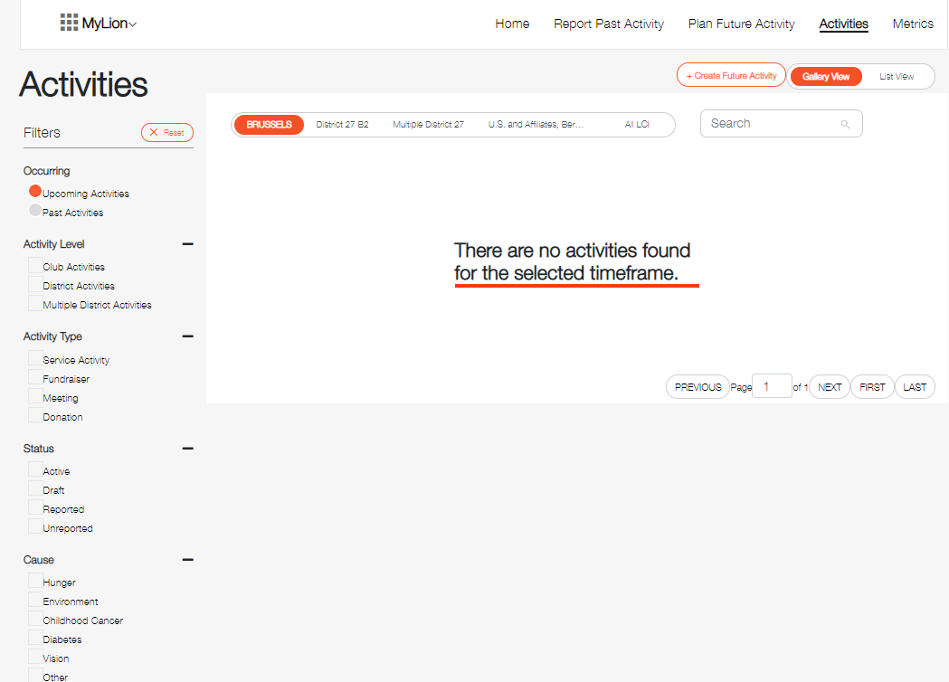
(ACTIVITIES)
o

Slide 49
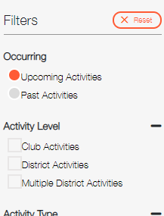
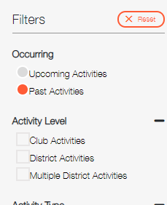
(ACTIVITIES)
o

Slide 50
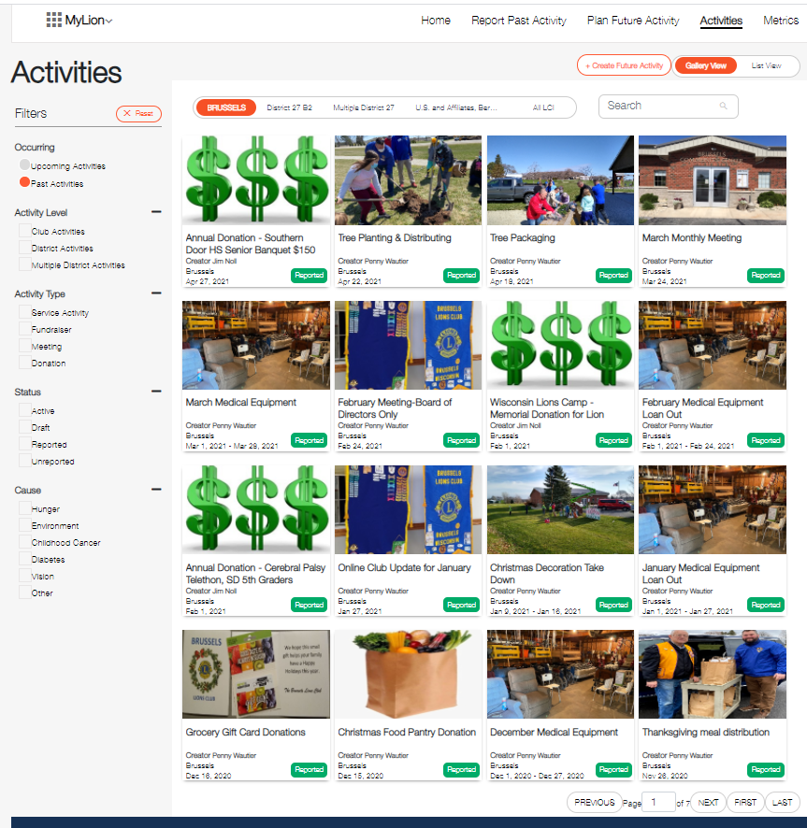
(ACTIVITIES)
o

Slide 51
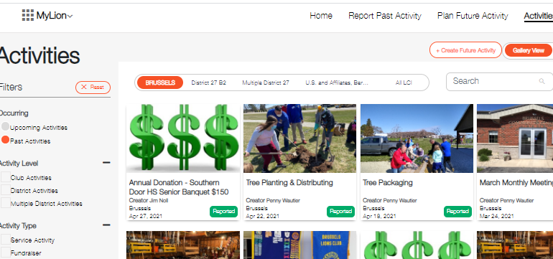
(ACTIVITIES)
o

Slide 52
(METRICS)
o

Slide 53
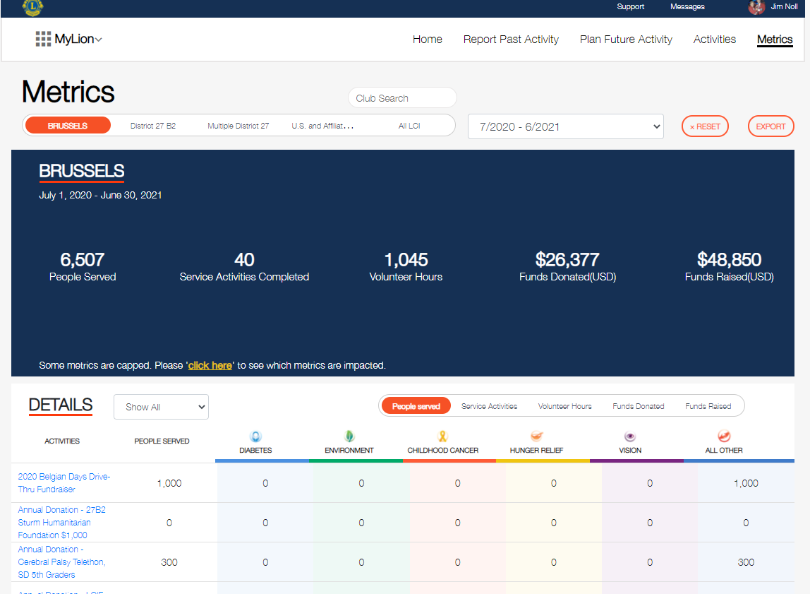
(METRICS)
o

Slide 54
(METRICS)
o

Slide 55
(METRICS)
o

Slide 56
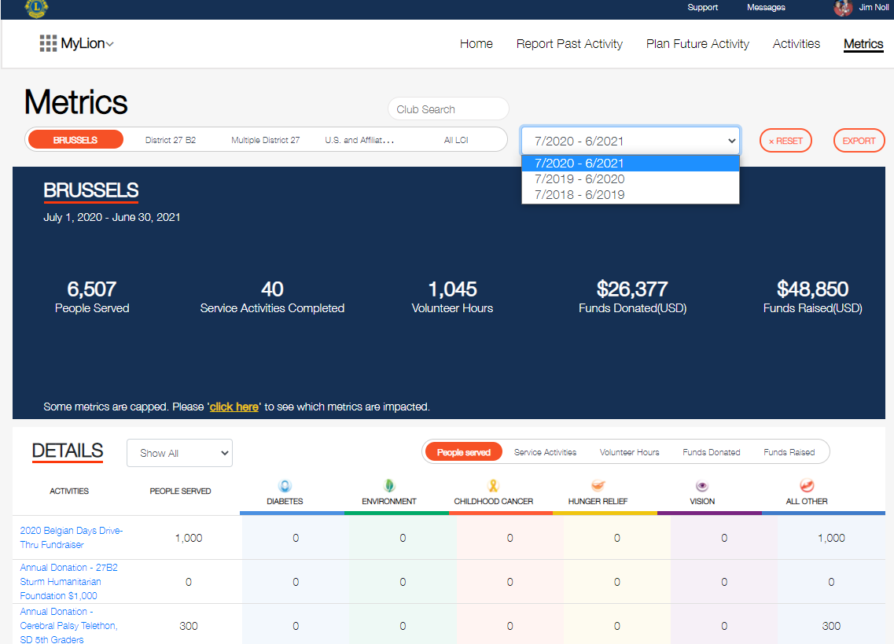
(METRICS)
o

Slide 57
(METRICS)
o

Slide 58
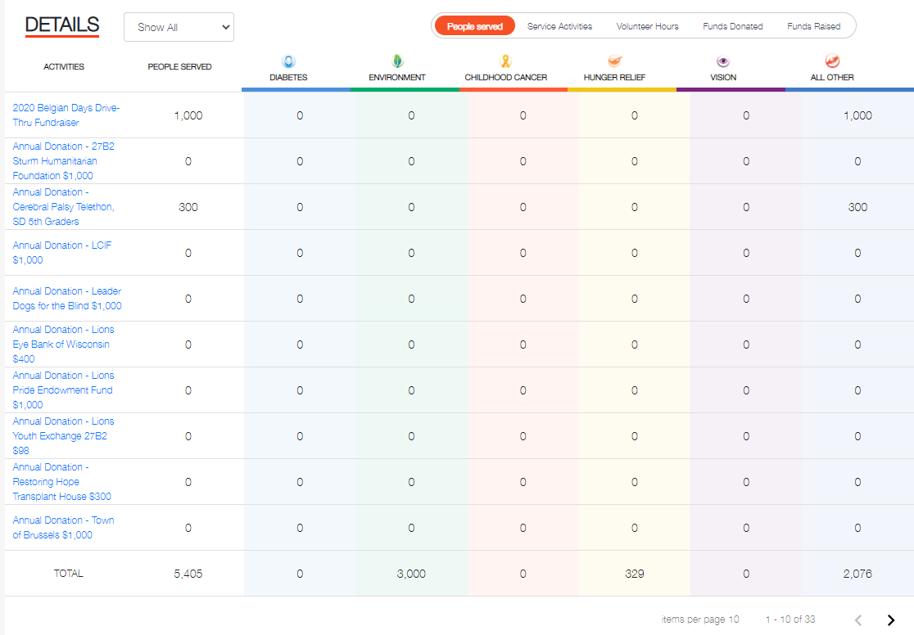
(METRICS)
o

Slide 59
(METRICS)
o

Slide 60
(METRICS)
o

Slide 61
(METRICS)
o

Slide 62
Using MyLion
EXPLORE
IT ON
YOUR OWN!
o

Slide 63
Resources
lionjim27b2@gmail.com
MyLCI (Membership)
Pick on the “SUPPORT” ribbon
o

Slide 64
Resources
o

Slide 65
Resources
lionjim27b2@gmail.com
MyLCI (Membership)
Pick on the “SUPPORT” ribbon
MyLion (Activities)
Look on YouTube for videos
o

Slide 66
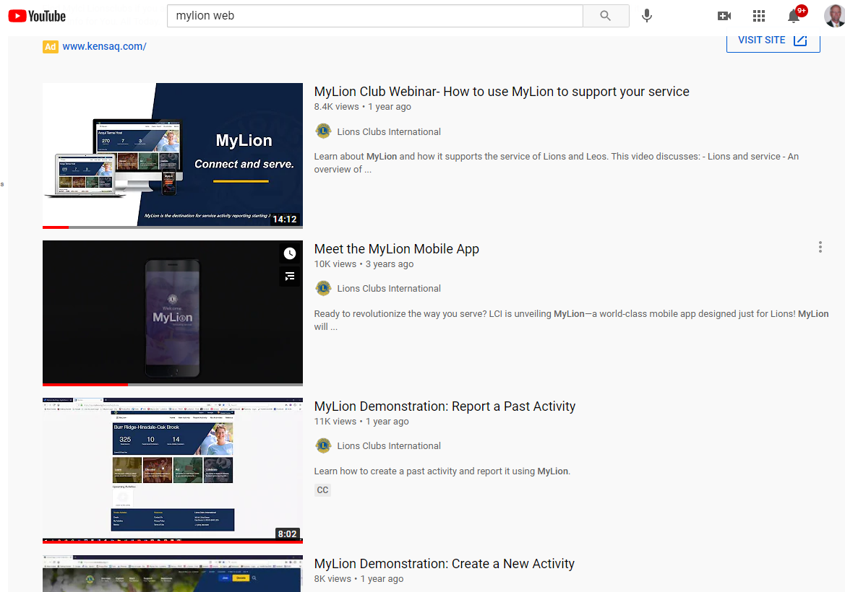
Resources
o

Slide 67
Resources
lionjim27b2@gmail.com
MyLCI (Membership)
Pick on the “SUPPORT” ribbon
MyLion (Activities)
Look on YouTube for videos
Join the Facebook “MyLion Forum” group
o

Slide 68
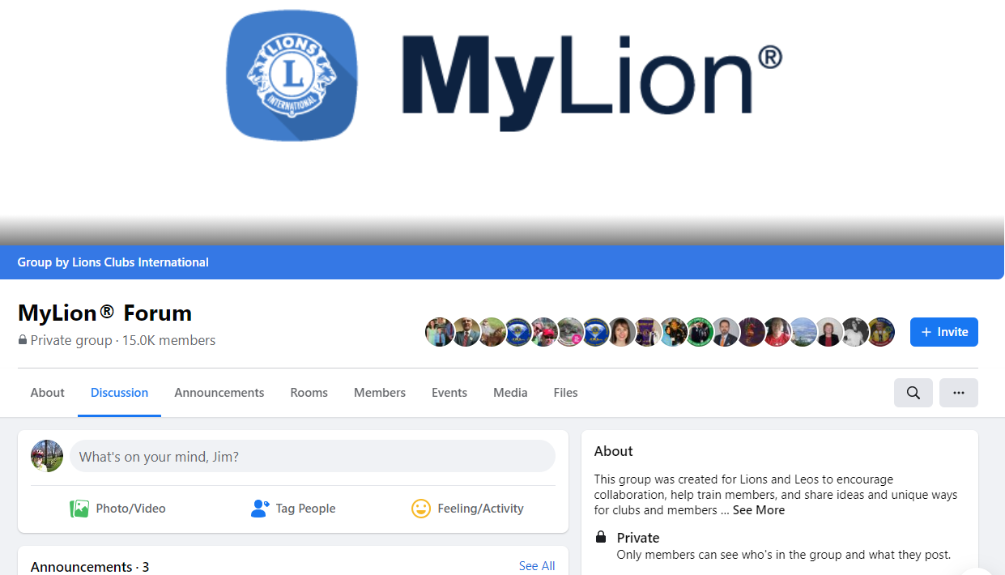
Resources
Facebook Group
o

Slide 69
Resources
lionjim27b2@gmail.com
MyLCI (Membership)
Pick on the “SUPPORT” ribbon
MyLion (Activities)
Look on YouTube for videos
Join the Facebook “MyLion Forum” group
A step-by-step instructions booklet
Email me
MyLion Forum “Files” on Facebook
o

Slide 70
Resources
o

Slide 71
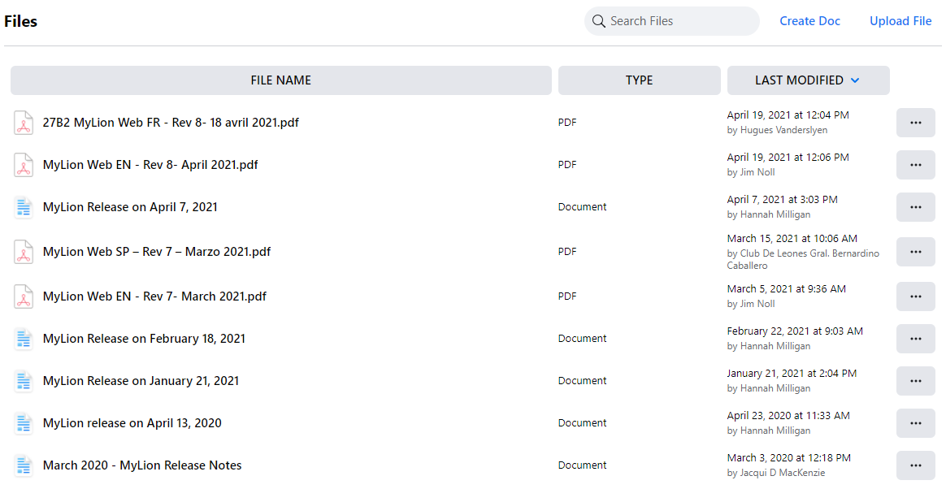
Resources
o

Slide 72
Resources
lionjim27b2@gmail.com
MyLCI (Membership)
Pick on the “SUPPORT” ribbon
MyLion (Activities)
Look on YouTube for videos
Join the Facebook “MyLion Forum” group
Step-by-step instructions
Email me
MyLion Forum “Files” on Facebook
o

Slide 73
What we will cover today
How we got to where we are today
Registering for Access
The basics of MyLCI – (Membership)
The basics of MyLion – (Activities)
Questions & Answers
o

Slide 74
o

Slide 75
Use the current emblem!
Can be downloaded from the LCI website,
search “Logos and Emblems”
o

Slide 76
Thank You
o

